Slide 1



Impact assessment frameworks as policy instrument: the example of the REF
AESIS, November 2019
David Sweeney, Research England
Notes:
The abstract pattern can be removed or repositioned if required. Be careful to ‘Send to Back’ so that it does not obscure any important information.

Slide 2
Research Contributing to Society
Why we did it
What we did
How it has turned out
Evaluation
What has happened since
Notes:
Replace this guidance text with your own bullet pointed content.
For further guidance please see https://www.bdadyslexia.org.uk/advice/employers/creating-a-dyslexia-friendly-workplace/dyslexia-friendly-style-guide

Slide 3
Outline
The challenge from the UK government
The economic context –
Issues to consider in the international context
The universities and academics response
Progress
Notes:
Replace this guidance text with your own bullet pointed content.
For further guidance please see https://www.bdadyslexia.org.uk/advice/employers/creating-a-dyslexia-friendly-workplace/dyslexia-friendly-style-guide

Slide 4
The Challenge from HM Treasury
‘Convince us that increased research investment is worthwhile’
  From their point of view – a reasonable question!
  Playing back senior policy-makers arguments for investment
  A rational economic argument (not a rhetorical political argument)
  A question we thought we could answer
  But to many academics it was a difficult question
  Broaden the definition of ‘best’
  Evaluation vs impact
Notes:
Replace this guidance text with your own bullet pointed content.
For further guidance please see https://www.bdadyslexia.org.uk/advice/employers/creating-a-dyslexia-friendly-workplace/dyslexia-friendly-style-guide

Slide 5
What kind of research impact
Impact not evaluation
Assessment not measurement
Institutions (not universities) not projects
Retrospective not prospective (can’t predict impact…)
All disciplines, not some
Comparative, not absolute
Notes:
Replace this guidance text with your own bullet pointed content.
For further guidance please see https://www.bdadyslexia.org.uk/advice/employers/creating-a-dyslexia-friendly-workplace/dyslexia-friendly-style-guide

Slide 6

Notes:
Please feel free to replace this image with one of your own.

Slide 7
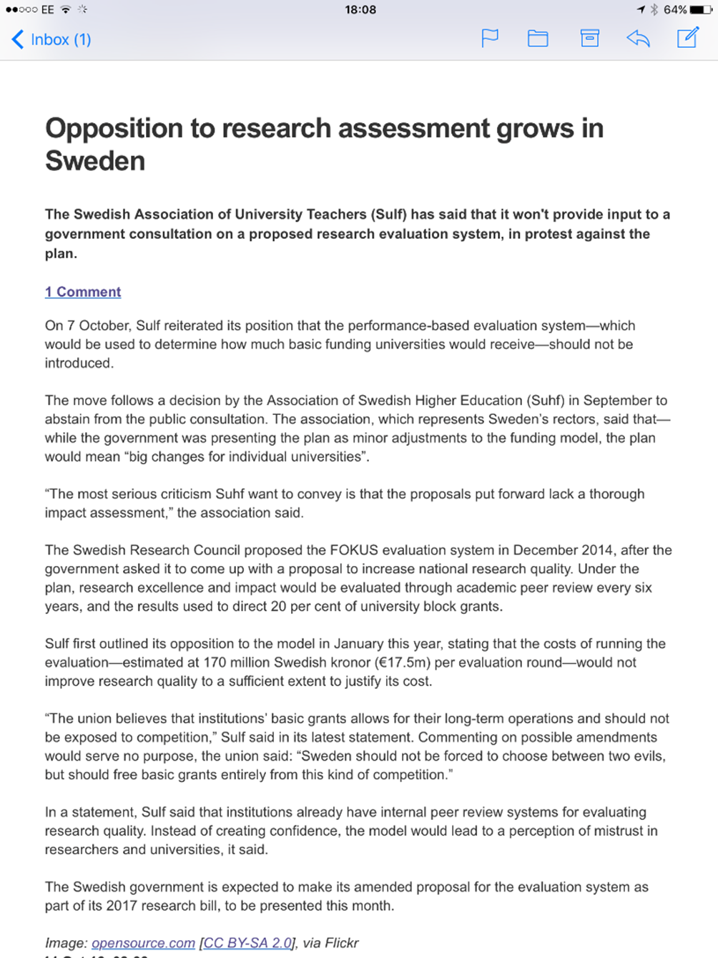
Notes:
Please feel free to replace this image with one of your own.

Slide 8
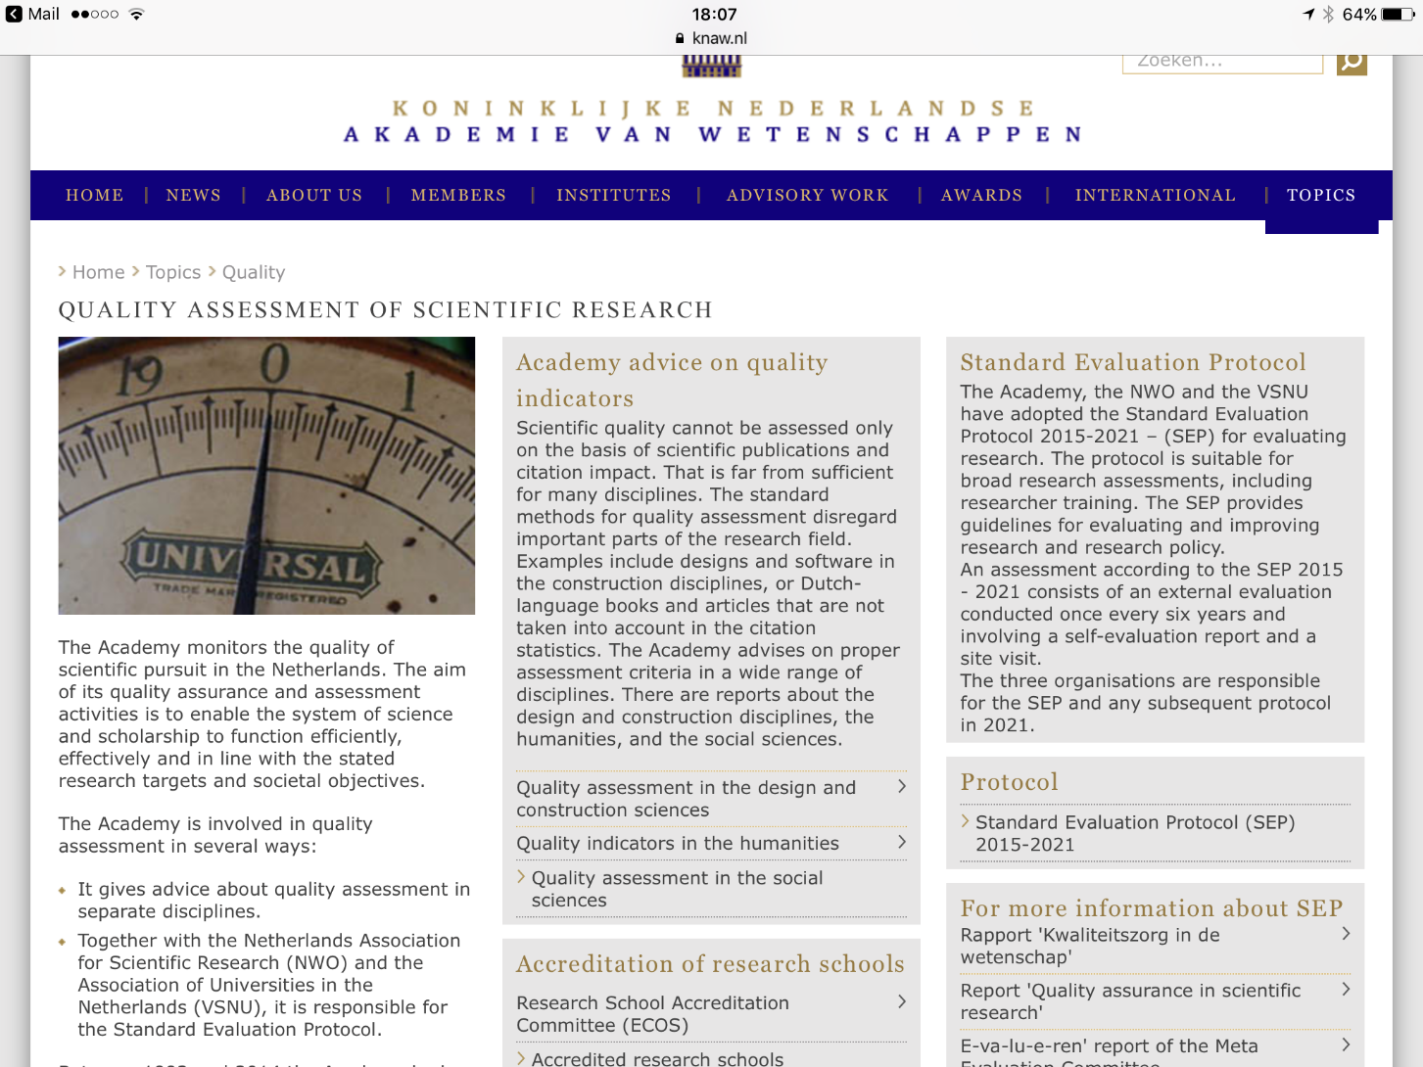
Notes:
Please feel free to replace this image with one of your own.

Slide 9
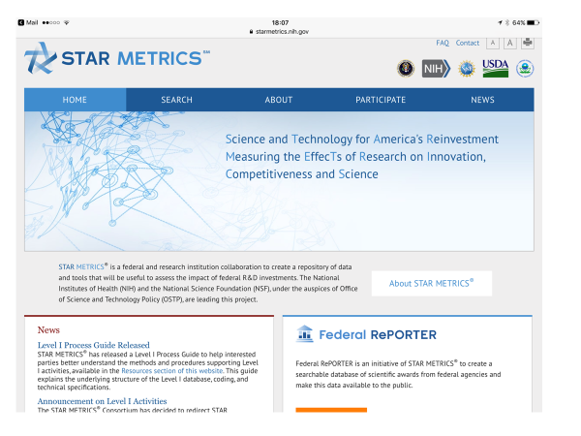
Notes:
Please feel free to replace this image with one of your own.

Slide 10
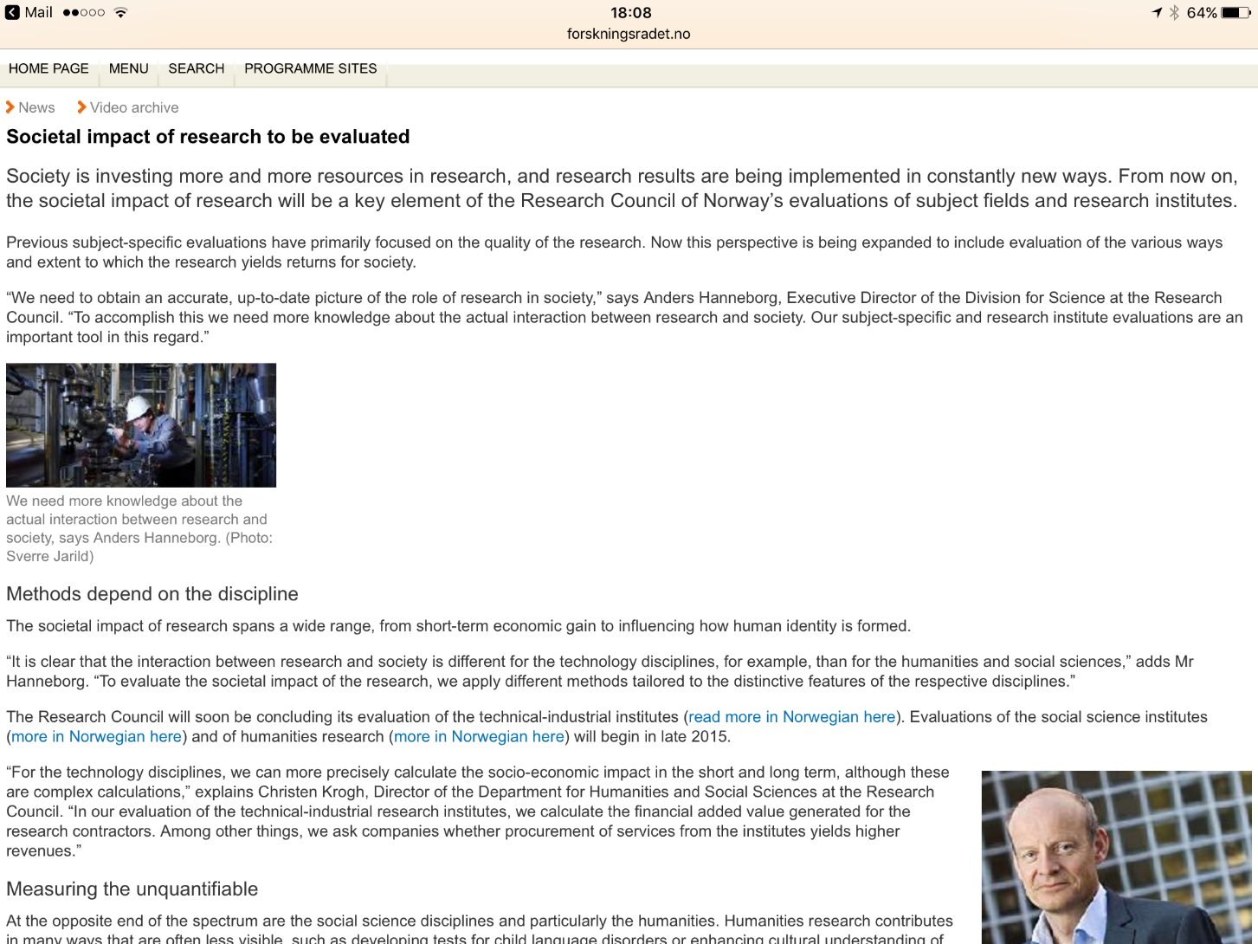

Slide 11


Slide 12


Slide 13


Slide 14
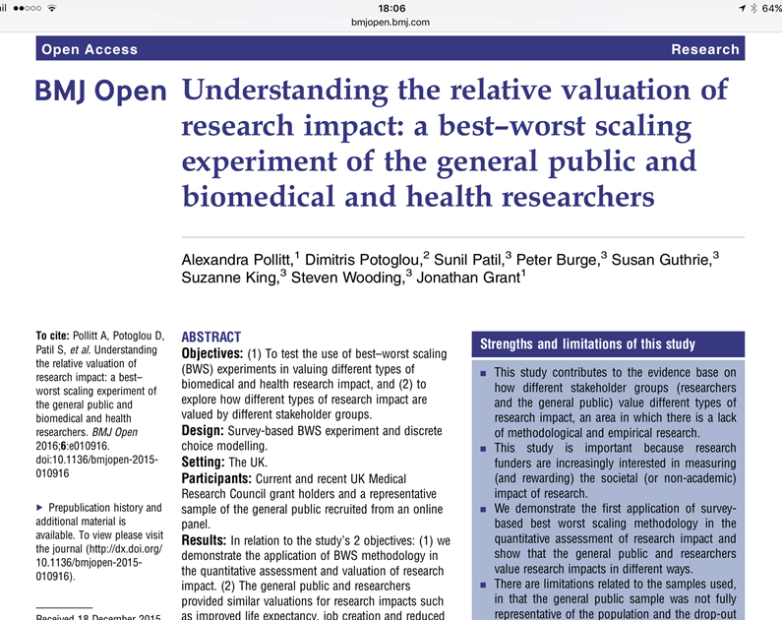

Slide 15
European Union
Setting out his vision for Framework 9 for the first time at a conference on the European Research Area in Berlin on 10 October, Carlos Moedas said that impact was one of three ‘core values’ that he thinks the programme should have. The other two – excellence and openness – have already received a great deal of attention in Horizon 2020.
Notes:
Replace this guidance text with your own bullet pointed content.
For further guidance please see https://www.bdadyslexia.org.uk/advice/employers/creating-a-dyslexia-friendly-workplace/dyslexia-friendly-style-guide

Slide 16
European Union (2)
In his speech, Moedas said that the Commission and researchers “have an obligation and an incentive to be much better at understanding and communicating the impact of what we do”. He said that more could be done to “capture and measure different kind of outputs – including the unexpected ones”, and that he hoped the next Framework programme could have a “more sophisticated approach” to impact’.
Notes:
Replace this guidance text with your own bullet pointed content.
For further guidance please see https://www.bdadyslexia.org.uk/advice/employers/creating-a-dyslexia-friendly-workplace/dyslexia-friendly-style-guide

Slide 17
European Union (3)
‘Moedas didn’t specify what this approach would be. But national government, mostly in northern Europe, that have implemented ‘impact agendas’ have called on grant applicants to draw up plans for ensuring impact in areas such as policy, public understanding, publications, patents and industrial application.’
Notes:
Replace this guidance text with your own bullet pointed content.
For further guidance please see https://www.bdadyslexia.org.uk/advice/employers/creating-a-dyslexia-friendly-workplace/dyslexia-friendly-style-guide

Slide 18
Different approaches
UK – Knowledge Transfer metrics (HE-BCI and HEIF, income based)
Australia – ‘engagement and impact’
USA – Star Metrics (intervention-based)
EU – Moedas – Prospective to assess grants (cf UK Research Councils)
UK Health Research – Best/Worst
Grants for USA – Measuring research – A guide to research evaluation frameworks and tools
Notes:
Replace this guidance text with your own bullet pointed content.
For further guidance please see https://www.bdadyslexia.org.uk/advice/employers/creating-a-dyslexia-friendly-workplace/dyslexia-friendly-style-guide

Slide 19
Government response
Acknowledged that impact was now a major driver (which was win for us long before we assessed impact)
Because of impact the whole frame of reference around research had shifted – far more important than the mechanics of assessment
Science and Research investment protected while the rest of public investment cut by at least 30%
At enormous political cost, investment in education was protected by passing the cost to the graduate
Universities declared to be at the heart of business recovery, particularly outside London and the South East
University investment used to unlock the capital which big business was sitting on
Notes:
Replace this guidance text with your own bullet pointed content.
For further guidance please see https://www.bdadyslexia.org.uk/advice/employers/creating-a-dyslexia-friendly-workplace/dyslexia-friendly-style-guide

Slide 20
What it was & what it wasn’t
Demonstrating the contribution to society:
  Not about conceding the authority to dictate research directions
  Not about moving to lots more applied research, but about validating the contribution of ‘fundamental’ research – although equally about recognising and rewarding applied work alike
  Not about favouring one discipline over another – equality of opportunity on this
  Not about replacing academic excellence by societal impact, but complementary and an opportunity to demonstrate the impact of academically excellent work
  Equally not about pretending that academic impact is societal impact
Notes:
Replace this guidance text with your own bullet pointed content.
For further guidance please see https://www.bdadyslexia.org.uk/advice/employers/creating-a-dyslexia-friendly-workplace/dyslexia-friendly-style-guide

Slide 21

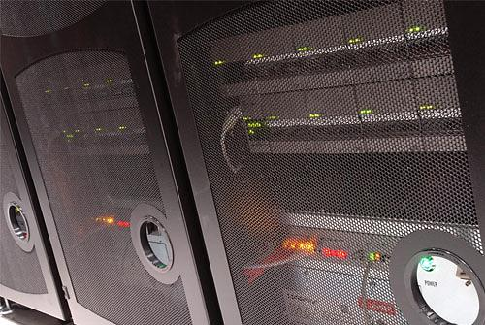
National objectives
  Intellectual leadership in the development of new knowledge
  ‘International comparative performance of the UK research base’– ‘better than world average in all subject fields based on field-weighted citation impacts
  ‘Well-rounded portfolio’
Notes:
Replace this guidance text with your own bullet pointed content.
For further guidance please see https://www.bdadyslexia.org.uk/advice/employers/creating-a-dyslexia-friendly-workplace/dyslexia-friendly-style-guide

Slide 22


National objectives (2)
  Optimal contribution to society from that new knowledge – ‘Impact’
    Culture change & broad engagement of universities/academics
    Greater investment from business, not just to capture cash, but to support shared objectives
  ‘When do we want it’ – now,
  of course, but recognising
  that is based on past
  investment
  Long-term success e.g.
  e-infrastructure, graphene
Notes:
Replace this guidance text with your own bullet pointed content.
For further guidance please see https://www.bdadyslexia.org.uk/advice/employers/creating-a-dyslexia-friendly-workplace/dyslexia-friendly-style-guide

Slide 23

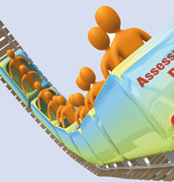
Determining a strategy
Performance-based funding
  Past success is a good guide to future success in a stable environment with long cycles
  A mixture of metrics, peer judgement and expert advice to determine ‘excellence’
Public funding to unlock
private funding
Investing now for long-term
success
Notes:
Replace this guidance text with your own bullet pointed content.
For further guidance please see https://www.bdadyslexia.org.uk/advice/employers/creating-a-dyslexia-friendly-workplace/dyslexia-friendly-style-guide

Slide 24
Research Assessment (UK)
  Research Assessment Exercise – RAE
    Periodically since 1986
    Primarily a peer review exercise for all disciplines – metrics play a strictly limited part
    Carries the confidence of academics and universities
    A selective exercise, not an assessment of all UK research
    The single most important driver for academics and universities in the United Kingdom.
    Liked by Government as allows funding based on quality, unlike teaching.
    Now the Research Excellence Framework - REF
Notes:
Replace this guidance text with your own bullet pointed content.
For further guidance please see https://www.bdadyslexia.org.uk/advice/employers/creating-a-dyslexia-friendly-workplace/dyslexia-friendly-style-guide

Slide 25
REF: A UK-Wide Framework
  ‘Aiming to maintain the capacity of higher education to undertake world-leading research across a range of academic disciplines, promote economic growth and national well-being and the expansion and dissemination of knowledge’
    Delivered by the REF team on behalf of the four funding bodies
    Drives our selective allocations of research funding, supporting excellence wherever it is found, with strong performance incentive
    Provides international benchmarks and reputational yardsticks
    Provides accountability and demonstrates the benefits of public investment in research
    Evidence base for strategic decisions at national level
    Used by universities and others for resource allocation decisions
    It provides a periodically updated reputational benchmark, which is based on rigorous peer judgement by fellow academics
Notes:
Replace this guidance text with your own bullet pointed content.
For further guidance please see https://www.bdadyslexia.org.uk/advice/employers/creating-a-dyslexia-friendly-workplace/dyslexia-friendly-style-guide

Slide 26

How it works
REF assesses the quality of research in all UK universities, in all disciplines. It is carried out by 36 expert panels, grouped into 4 main panels.
Main Panel A: Medical and life sciences
Main Panel B: Physical sciences and engineering
Main panel C: Social sciences
Main Panel D: Arts and humanities
2011-12
Preparation
Panels were appointed.
Guidance and criteria were published.
2012-13
Submissions
Universities made submissions in whichever subjects they chose to.
2014
Assessment
36 expert panels reviewed the submissions, guided by the 4 main panels.

Slide 27
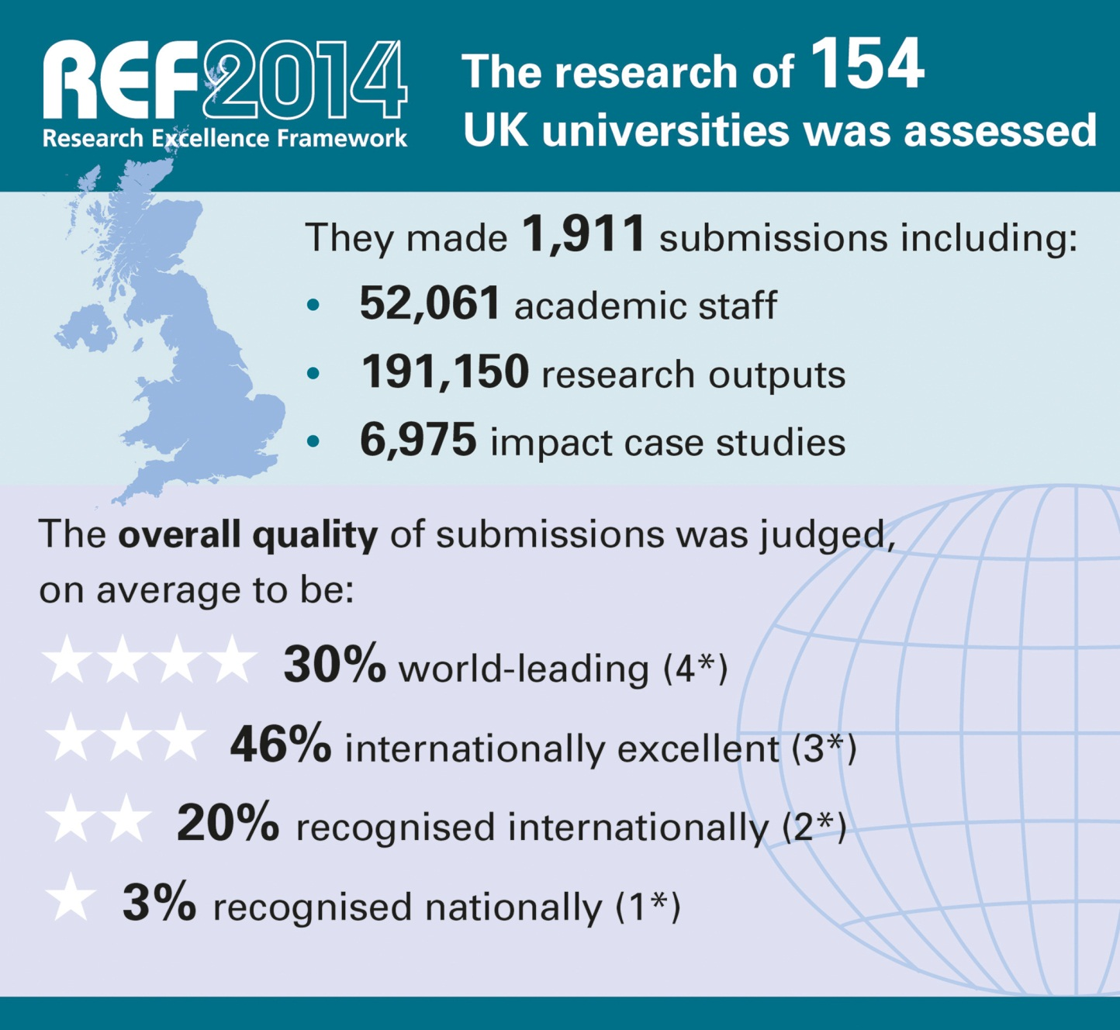
Notes:
The primary outcome will be an overall quality profile for each submission, this will show the proportion of research judged to meet each of the four starred quality levels and will indicate the (FTE) number of staff in each submission
The funding bodies intend to use the assessment outcomes to inform the selective allocation of their research funding to HEIs, with effect from 2015-16; as Graeme said, ~£2 billion per year.
We will also publish all submissions in spring 2015. We will remove personal and contractual details. HEIs may also redact textual parts of their submission which should be excluded for reasons of commercial sensitivity or security
As Vicky Said, submitting HEIs must also produce a Code of Practice on the selection of staff for the REF, these COPs will also be published at the end of the exercise.
Back to Graeme to wrap up.

Slide 28
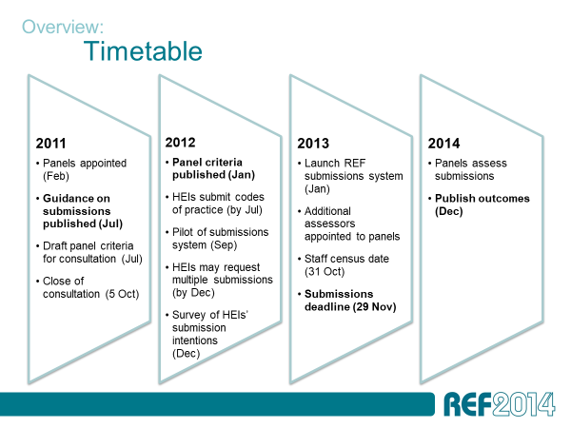
Notes:
Replace this guidance text with your own bullet pointed content.
For further guidance please see https://www.bdadyslexia.org.uk/advice/employers/creating-a-dyslexia-friendly-workplace/dyslexia-friendly-style-guide

Slide 29
The assessment framework
Overview:
Overall quality
Maximum of 4 outputs per researcher
Impact template and case studies
Environment data and template
Outputs
Impact
Environment
65%
20%
15%

Slide 30
Timetable
Overview:
2011
2012
2013
Submissions deadline (29 Nov)
2014
Panels assess submissions
Publish outcomes (Dec)
Panel criteria published (Jan)
Guidance on submissions published (Jul)
Panels appointed (Feb)
Draft panel criteria for consultation (Jul)
Survey of HEIs’ submission intentions (Dec)
Launch REF submissions system (Jan)
Additional assessors appointed to panels
Staff census date (31 Oct)
HEIs submit codes of practice (by Jul)
Close of consultation (5 Oct)
HEIs may request multiple submissions (by Dec)
Pilot of submissions system (Sep)

Slide 31
For the first time, REF has demonstrated the impact of UK research in all subjects
Over 250 research users judged the impacts, jointly with academic panel members.
44% of impacts were judged outstanding (4*). A further 40% were judged very considerable (3*).
Impressive impacts were found from research in all subjects.
REF shows many ways in which research has fuelled economic prosperity, influenced public policy and services, enhanced communities and civic society, enriched cultural life, improved health and wellbeing, and tackled environmental challenges.

Slide 32
Impact: Submissions
Impact template (REF3a)
Sets out the submitted unit’s general approach to enabling impact from its research
Case studies (REF3b)
Contributed 20% to the impact sub-profile
Specific examples of impacts that were underpinned by the submitted unit’s research
Contributed 80% to the impact sub-profile
Covered the period 1 Jan 2008 to 31 Jul 2013
One template per submission – with a page limit depending on the number of staff submitted
Impacts during 1 Jan 2008 to 31 Jul 2013; underpinned by research since 1 Jan 1993
The number of case studies required depends on the number of staff submitted
Notes:
32

Slide 33
Impact: Template (REF3a)
  The unit’s approach to enabling impact from its research:
    Context for the approach
    The unit’s approach during 2008-2013
    Strategy and plans for supporting impact
    Relationship to the submitted case studies
  Provided additional information and context for the case studies, and could take account of particular circumstances that may have constrained a unit’s selection of case studies
  Assessed in terms of the extent to which the unit’s approach was conducive to achieving impact of ‘reach and significance’
Notes:
Key goals for the decade:
World class research at the UK’s strongest centres of excellence
Greater responsiveness of the publicly-funded research base to the needs of the economy
Increase the number of businesses collaborating with universities and public sector research establishments
Research stats here taken from ‘Evidence Ltd/Thomson Reuters 2009, International comparative performance of UK research base’.
33

Slide 34
Impact: Case studies (REF3b)
  In each case study, the impact described needed to:
    Meet the REF definition of impact
    Have occurred between 1 Jan 2008 and 31 July 2013 (could have be at any stage of maturity)
    Be underpinned by excellent research (at least 2* quality) produced by the submitting unit between 1 Jan 1993 to 31 Dec 2013
  Submitted case studies needed not be representative of activity across the unit: pick the strongest examples
Notes:
Key goals for the decade:
World class research at the UK’s strongest centres of excellence
Greater responsiveness of the publicly-funded research base to the needs of the economy
Increase the number of businesses collaborating with universities and public sector research establishments
Research stats here taken from ‘Evidence Ltd/Thomson Reuters 2009, International comparative performance of UK research base’.
34

Slide 35
Impact: Case studies (REF3b)
  Each case study was limited to 4 pages and must have:
    Described the underpinning research produced by the submitting unit
    Referenced one or more key outputs and provide evidence of the quality of the research
    Explained how the research made a ‘material and distinct’ contribution to the impact (there are many ways in which this may have taken place)
    Explained and provided appropriate evidence of the nature and extent of the impact: Who / what was affected? How were they affected? When?
    Provide independent sources that could have been used to verify claims about the impact (on a sample audit basis)
Notes:
Key goals for the decade:
World class research at the UK’s strongest centres of excellence
Greater responsiveness of the publicly-funded research base to the needs of the economy
Increase the number of businesses collaborating with universities and public sector research establishments
Research stats here taken from ‘Evidence Ltd/Thomson Reuters 2009, International comparative performance of UK research base’.
35

Slide 36
What about Metrics
http://www.hefce.ac.uk/rsrch/REFreview/evaluation/What we did
http://www.kcl.ac.uk/sspp/policy-institute/publications/Analysis-of-REF-impact.pdf
‘The quantitative evidence supporting claims for impact was diverse and inconsistent, suggesting that the development of robust impact metrics is unlikely’
Notes:
36

Slide 37
Impact Background (2)
  Definition: ‘Research impact is the demonstrable contribution that research makes to the economy, society, culture, national security, public policy or services, health, the environment, or quality of life, beyond contributions to academia.’
  REF definition: ‘Effect on, change or benefit to the economy, society, culture, public policy or services, health, the environment or quality of life beyond academia’
Notes:
[NB this is not a definitive interpretation or full list of aims and is intended as a guide only]
NOTES
CONTEXT
The White Paper sets out Government reforms for HE. This will entail significant system change (a single, unified regulatory framework, new student number control); legislative change (increased fee cap, new interest rate, new powers for HEFCE as the ‘lead regulator’) and organisational change (rapid adjustment of universities and colleges to the ‘new world’ including a focus on working with employers and industry)
It’s overall aim is stated as ‘…better HE that is more responsive to student choice, that provides a better student experience and that helps improve social mobility’. (The phrases ‘better student experience and better qualified graduates’ are taken from the White Paper – Chapter 3)
Key aims of the White Paper include
Sustainability: by putting HE on a sustainable financial footing, the Government wants universities and colleges to deliver a better student experience and take more responsibility for increasing social mobility
Choice: It puts students in the driving seat, with a focus on supporting students to make much more informed decisions about what degree to take and where to study it. This will also include having better information about jobs and salaries they could achieve
Dynamism: promoting a more competitive system in which universities compete more rigorously for students, resulting in a higher quality student experience with more innovative ways of learning
Competition: new regulatory framework aims to open up the sector and make it easier for new providers to enter, with further measures to facilitate successful institutions to expand. This will further improve student choice by supporting a more diverse sector, with more opportunities for part-time or accelerated courses, sandwich courses, distance learning and higher-level vocational study.

Slide 38
Research contribution
Our starting point was that an optimal submission should include a portfolio of excellent research and build on that excellent research to deliver benefits which contribute to society.
Contribution must be linked to high quality research
Assessed at the level of whole units (not individual outputs or researchers)
Equally demanding standards to the assessment of outputs
Notes:
[NB this is not a definitive interpretation or full list of aims and is intended as a guide only]
NOTES
CONTEXT
The White Paper sets out Government reforms for HE. This will entail significant system change (a single, unified regulatory framework, new student number control); legislative change (increased fee cap, new interest rate, new powers for HEFCE as the ‘lead regulator’) and organisational change (rapid adjustment of universities and colleges to the ‘new world’ including a focus on working with employers and industry)
It’s overall aim is stated as ‘…better HE that is more responsive to student choice, that provides a better student experience and that helps improve social mobility’. (The phrases ‘better student experience and better qualified graduates’ are taken from the White Paper – Chapter 3)
Key aims of the White Paper include
Sustainability: by putting HE on a sustainable financial footing, the Government wants universities and colleges to deliver a better student experience and take more responsibility for increasing social mobility
Choice: It puts students in the driving seat, with a focus on supporting students to make much more informed decisions about what degree to take and where to study it. This will also include having better information about jobs and salaries they could achieve
Dynamism: promoting a more competitive system in which universities compete more rigorously for students, resulting in a higher quality student experience with more innovative ways of learning
Competition: new regulatory framework aims to open up the sector and make it easier for new providers to enter, with further measures to facilitate successful institutions to expand. This will further improve student choice by supporting a more diverse sector, with more opportunities for part-time or accelerated courses, sandwich courses, distance learning and higher-level vocational study.

Slide 39
Assessing quality – ‘Impact Agenda’
To identify and reward the contribution that high quality research has made to the economy and society:
  Making these explicit to the Government and wider society
  Creating a level playing field between applied and theoretical work, but recognising only impact based on excellent research
  Encouraging institutions to achieve the full potential contribution of their research in future
  Intellectually coherent with the historical purposes of universities
Notes:
39

Slide 40
A wide view of impact
______________________________________________________________________________________________________________________________
Types of impact
Economic
Social
Public policy & services
Health
Cultural
Quality of life
International
Environment

Slide 41
Impact: Definition for the REF
  An effect on, change or benefit to the economy, society, culture, public policy or services, health, the environment or quality of life, beyond academia
  Impact includes an effect, change or benefit to:
    The activity, attitude, awareness, behaviour, capacity, opportunity, performance, policy, practice, process or understanding
    Of an audience, beneficiary, community, constituency, organisation or individuals
    In any geographic location whether locally, regionally, nationally or internationally
  It excludes impacts on research or the advancement of academic knowledge within HE; and impacts on teaching or other activities within the submitting HEI
Notes:
Key goals for the decade:
World class research at the UK’s strongest centres of excellence
Greater responsiveness of the publicly-funded research base to the needs of the economy
Increase the number of businesses collaborating with universities and public sector research establishments
Research stats here taken from ‘Evidence Ltd/Thomson Reuters 2009, International comparative performance of UK research base’.

Slide 42
Challenges of assessment
Time lags – we looked at impacts that were evident during REF period (from 2008-2012), underpinned by research over a longer timeframe
Attribution – case studies to tease out how the research contributed to the impacts
Limitations of metrics – expert panels assessed rather than measured impact; indicators were used as supporting evidence
Corroboration – there was scope for third party verification, and expert panels to judge credibility of the evidence

Slide 43
Assessment criteria
Expert panels assessed benefit in terms of their ‘reach’ and ‘significance’
All panels included substantial user representation – we suggested user members focus on the impact element, with reviewing outputs as ’optional’

Slide 44
This was not about
Quantifying impact
Focusing narrowly on economic impact
Assessing impact of every researcher or output
Trying to predict future impact
Discouraging curiosity-driven research
Trading-off impact and excellence
Notes:
44
44

Slide 45
Culture and society
A Impacts on society, culture and creativity:
Impacts where the beneficiaries are individuals, groups of individuals, organisations or communities whose knowledge, behaviours or practices have been influenced
B Impacts on society, culture and creativity
Impacts where the beneficiaries may include individuals, groups of individuals, organisations or communities whose knowledge, behaviours, creative practices and other activity have been influenced
C Impacts on creativity, culture and society: Impacts where the beneficiaries are individuals, groups of individuals, organisations or communities whose knowledge, behaviours, practices, rights or duties have been influenced
D Civil society Influencing the form and content of associations between people or groups to illuminate and challenge cultural values and social assumptions.
D Public discourse Extending the range and improving the quality of evidence, argument and expression to enhance public understanding of the major issues and challenges faced by individuals and society.
D Cultural life Creating and interpreting cultural capital in all of its forms to enrich and expand the lives, imaginations and sensibilities of individuals and groups.

Slide 46
Economic and Commercial
A Commercial impacts:
Impacts where the beneficiaries are usually companies, either new or established, or other types of organisation which undertake activity that creates wealth
A Economic impacts:
Impacts where the beneficiaries are usually the NHS or private health care or agricultural activity
B Economic impacts
Impacts where the beneficiaries may include businesses, either new or established, or other types of organisation which undertake activity that may create wealth
C Economic, commercial, organisational impacts:
Impacts where the beneficiaries may include new or established businesses, or other types of organisation undertaking activities which create wealth
D Economic prosperity Applying and transferring the insights and knowledge gained from research to create wealth in the manufacturing, service, creative and cultural sectors.

Slide 47
Health and welfare
A Health and welfare impacts:
Impacts where the beneficiaries are individuals and groups (both human and animals) whose quality of life has been enhanced (or potential harm mitigated)
B Health impacts
Impacts where the beneficiaries may include individuals (including groups of individuals) whose health outcomes have been improved or whose quality of life has been enhanced (or potential harm mitigated) through the application of enhanced healthcare for individuals or public health activities
C Health and welfare impacts:
Impacts where the beneficiaries are individuals and groups (human or animal) whose quality of life has been enhanced (or harm mitigated) or whose rights or interests have been protected or advocated

Slide 48
Public policy and services
A Impacts on public policy and services:
Impacts where the beneficiaries are usually government, public sector, and charity organisations and societies, either as a whole or groups of individuals in society, through the implementation of policies
B Impacts on public policy and services
Impacts where the beneficiaries may include government, non-governmental organisations (NGOs), charities and public sector organisations and society, either as a whole or groups of individuals in society
C Impacts on public policy, law and services: Impacts where the beneficiaries are usually government, public sector and charity organisations and societies, either as a whole or groups of individuals in society through the implementation or non-implementation of policies, systems or reforms
D Education Influencing the form or the content of the education of any age group in any part of the world where they extend significantly beyond the submitting HEI.
D Public services Contributing to the development and delivery of public services or legislation to support the welfare, education, understanding or empowerment of diverse individuals and groups in society, including the disadvantaged or marginalised.
D Policy making Influencing policy debate and practice through informed interventions relating to any aspect of human or animal well-being

Slide 49
Environment
A Impacts on the environment:
Impacts where the key beneficiary is the natural or built environment
B Impacts on the environment
Impacts where the key beneficiaries are the natural environment and/or the built environment, together with societies, individuals or groups of individuals who benefit as a result
C Impacts on the environment:
Impacts where the key beneficiaries are the natural, historic and/or built environment, together with societies, individuals or groups of individuals who benefit as a result

Slide 50
Practitioners and services
A Impacts on practitioners and services:
Impacts where beneficiaries are organisations or individuals, including service users involved in the development of and delivery of professional services
A Production impacts:
Impacts where the beneficiaries are individuals (including groups of individuals) whose production has been enhanced
B Impacts on practitioners and professional services
Impacts where beneficiaries may include organisations or individuals involved in the development of and delivery of professional services
C Impacts on practitioners and professional services:
Impacts where the beneficiaries may include organisations or individuals involved in the development and/or delivery of professional services and ethics

Slide 51
REF Case Studies: Outcomes
  Universities and academics galvanized due to the importance of REF
  6975 case studies
  Many focused on the long-term contribution of research to society
  Teased out the way in which impact arises
  Offered every discipline the opportunity to make its case in its own terms
  Stunning opportunity to build multi-disciplinary work into an exercise based around disciplines
  Evaluation by Rand Europe completed
Notes:
Key goals for the decade:
World class research at the UK’s strongest centres of excellence
Greater responsiveness of the publicly-funded research base to the needs of the economy
Increase the number of businesses collaborating with universities and public sector research establishments
Research stats here taken from ‘Evidence Ltd/Thomson Reuters 2009, International comparative performance of UK research base’.

Slide 52
Detail or Big Picture
Easy to criticise the detail which may or not work in other contexts
Arguing over detail misses ‘the wood for the trees’
  Do we want universities to be central to society?
  How does that sit with our traditional mission?
  Universities are already major economic actors – where do we sit with our consequent social responsibility?
Notes:
52

Slide 53

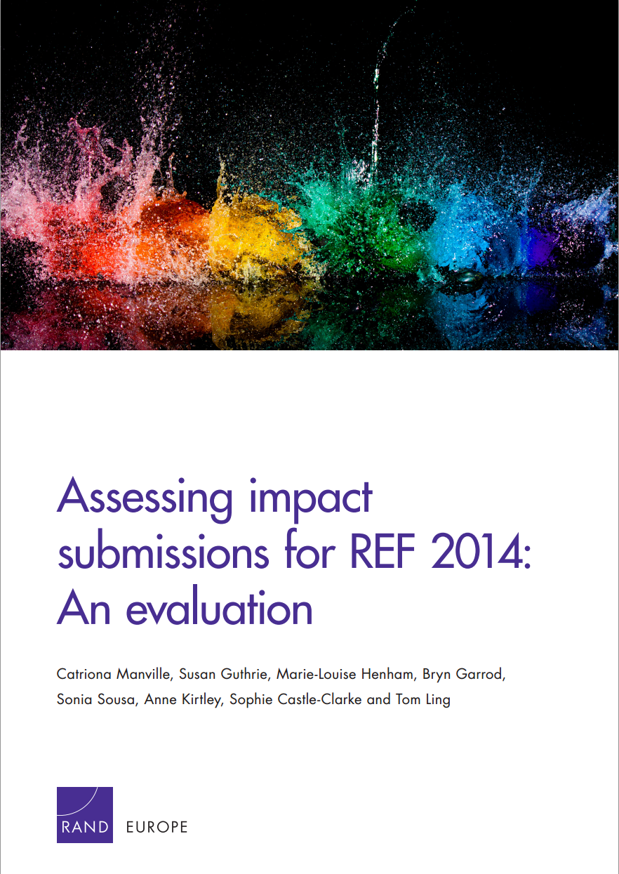
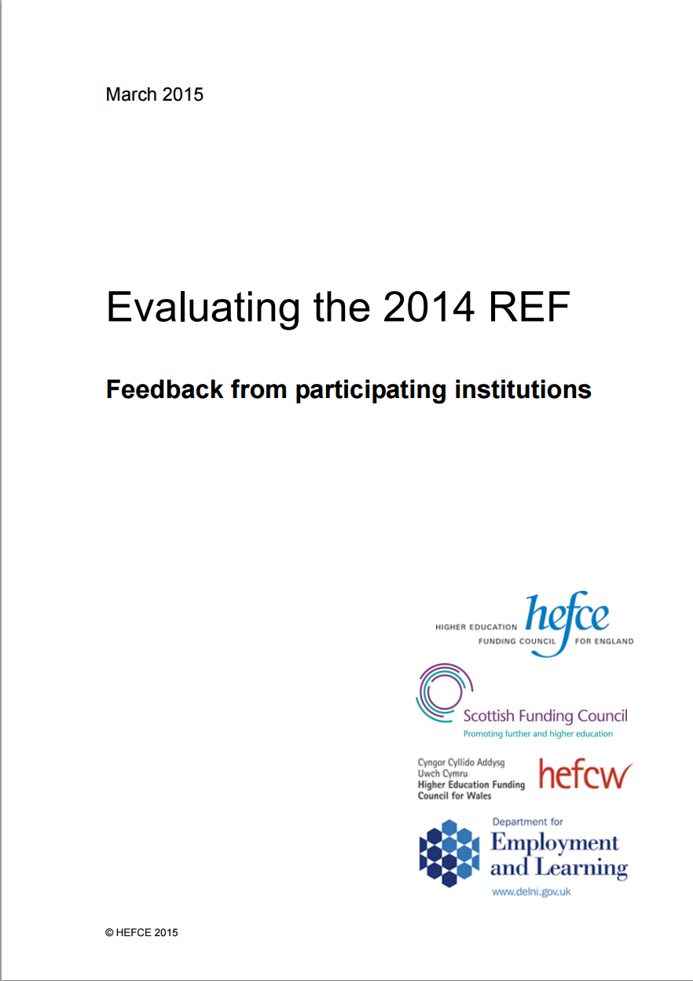
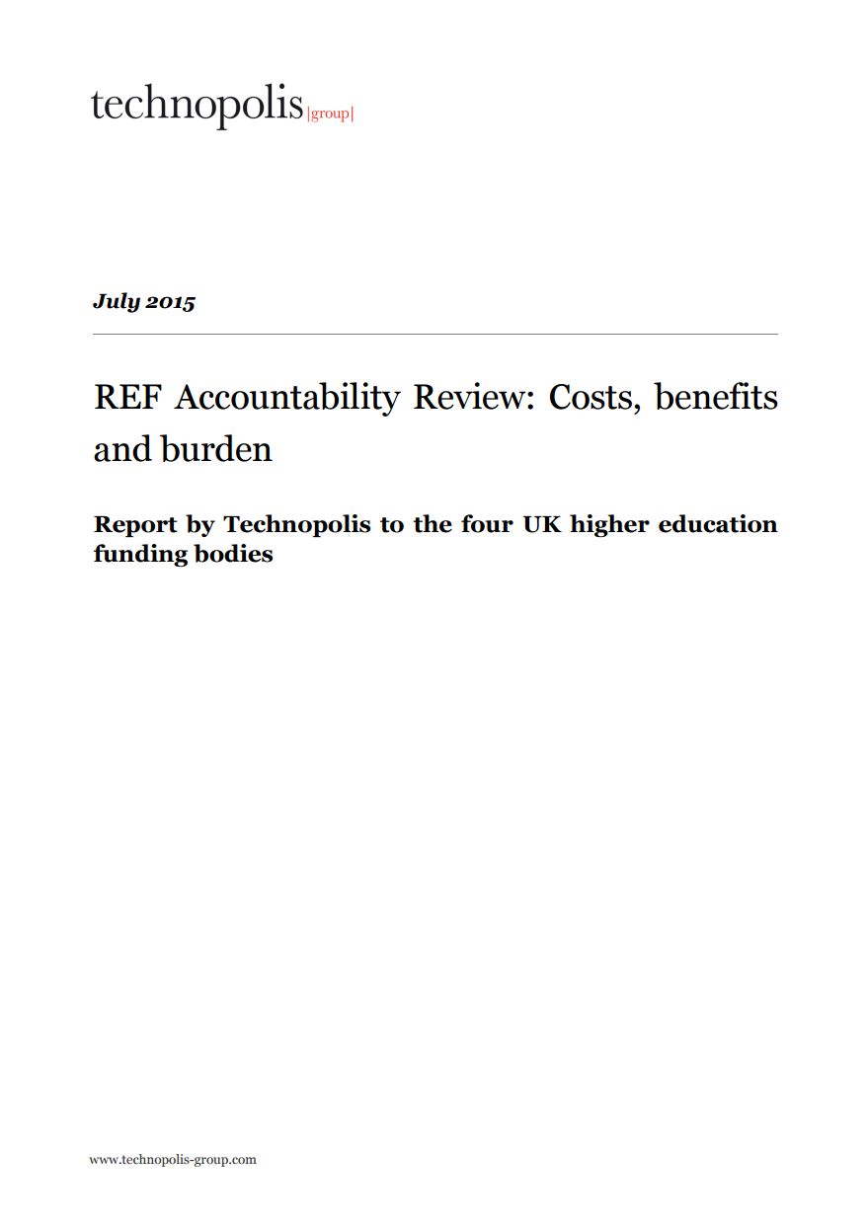
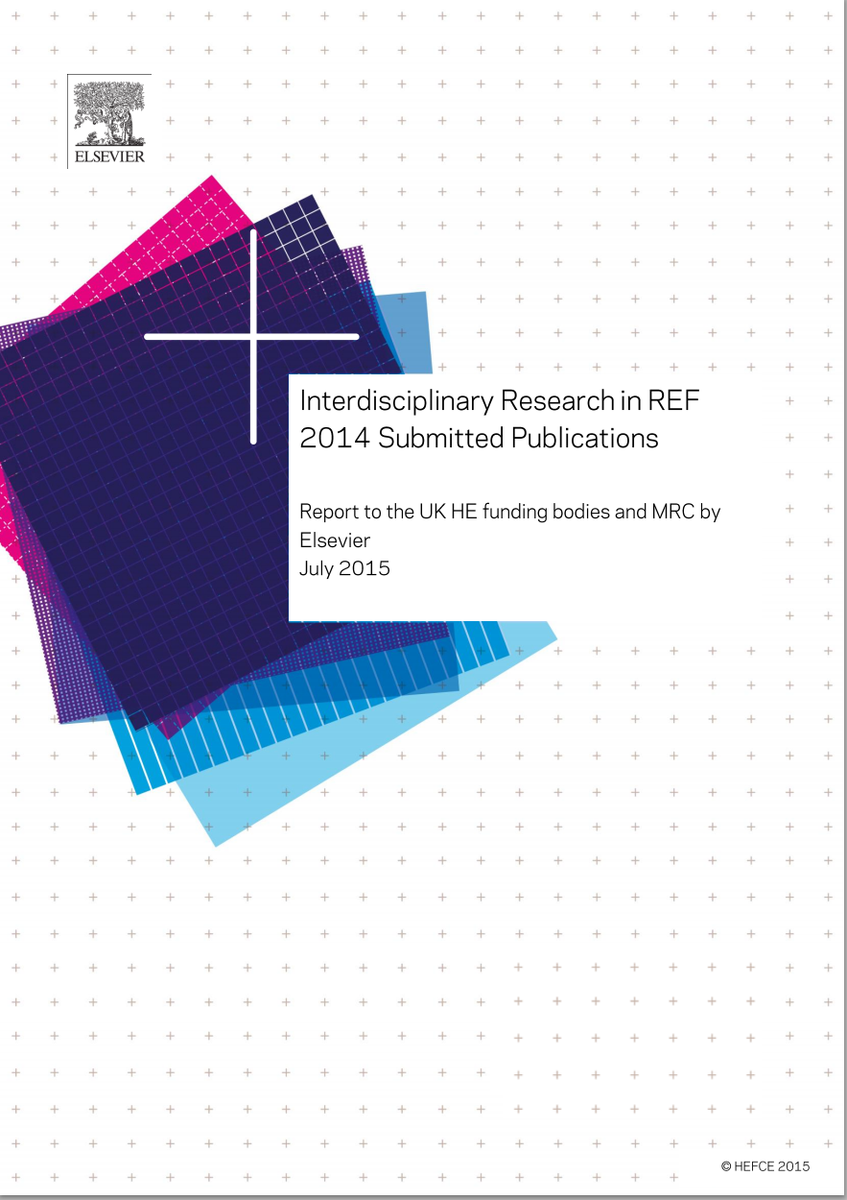
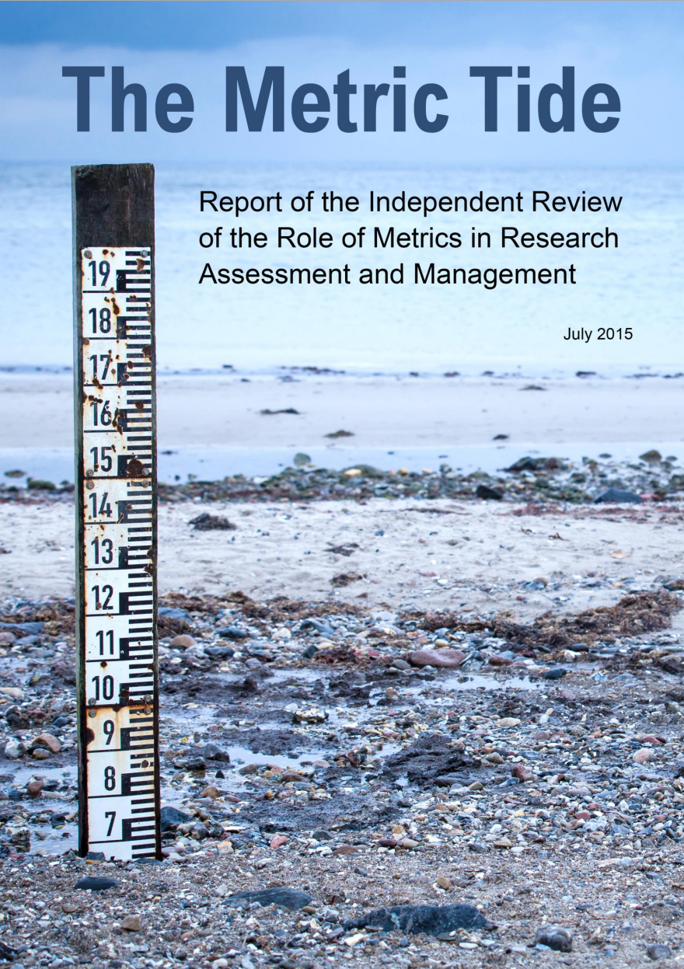
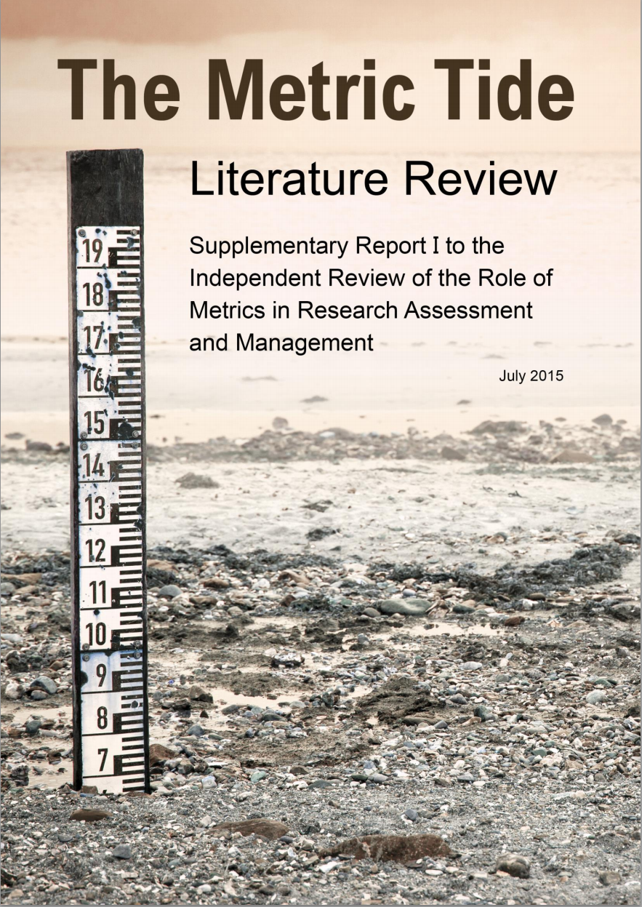
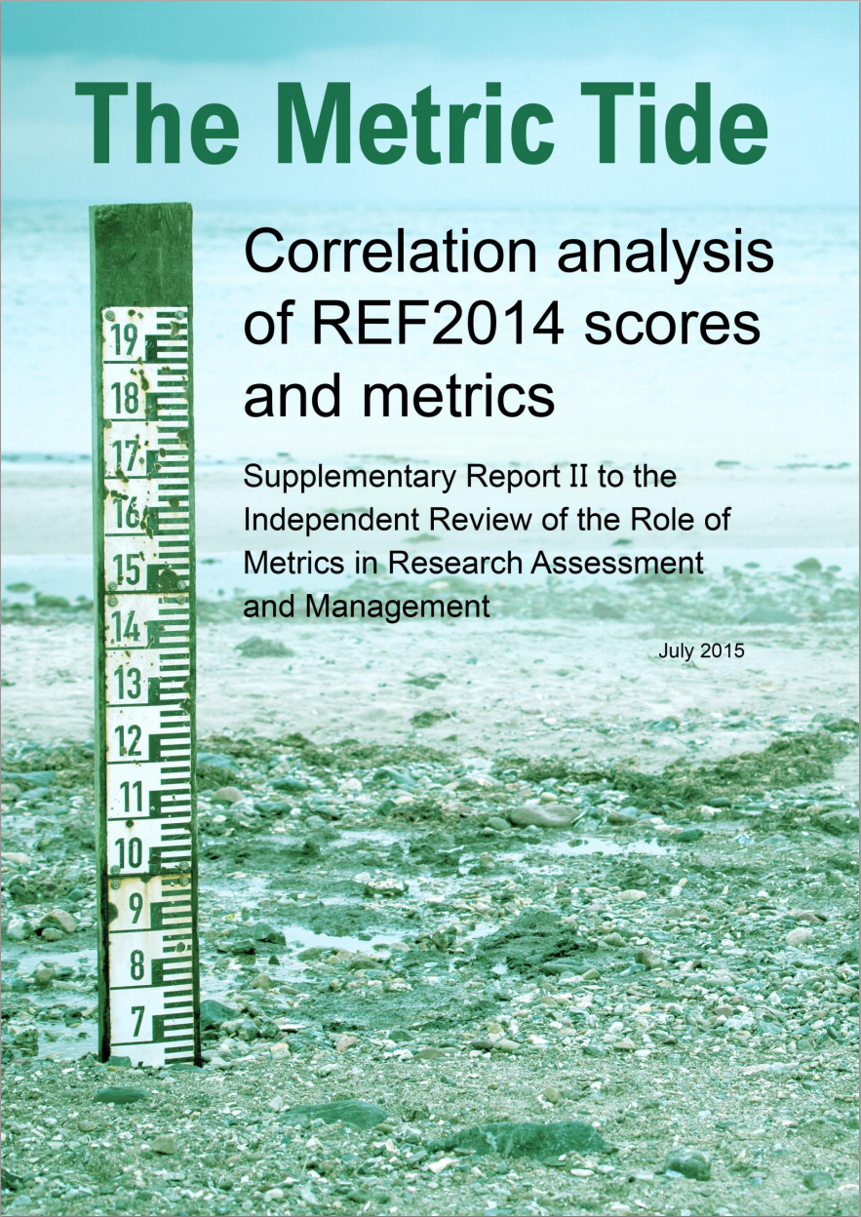
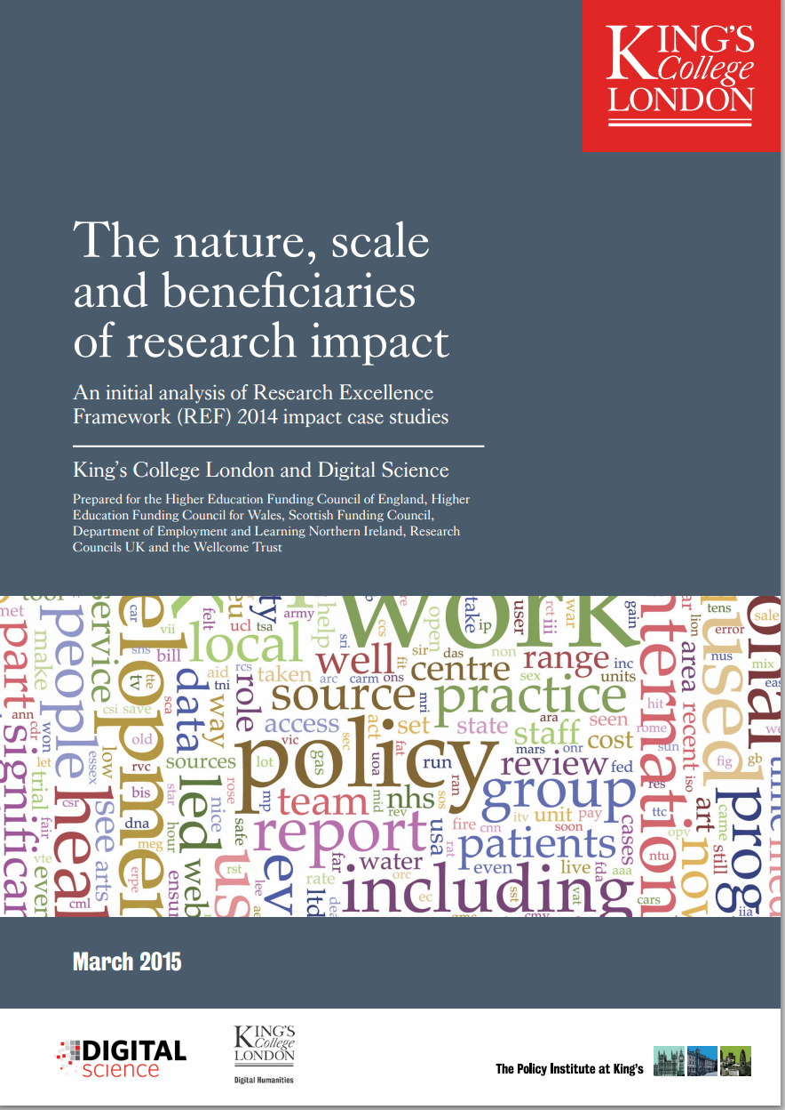
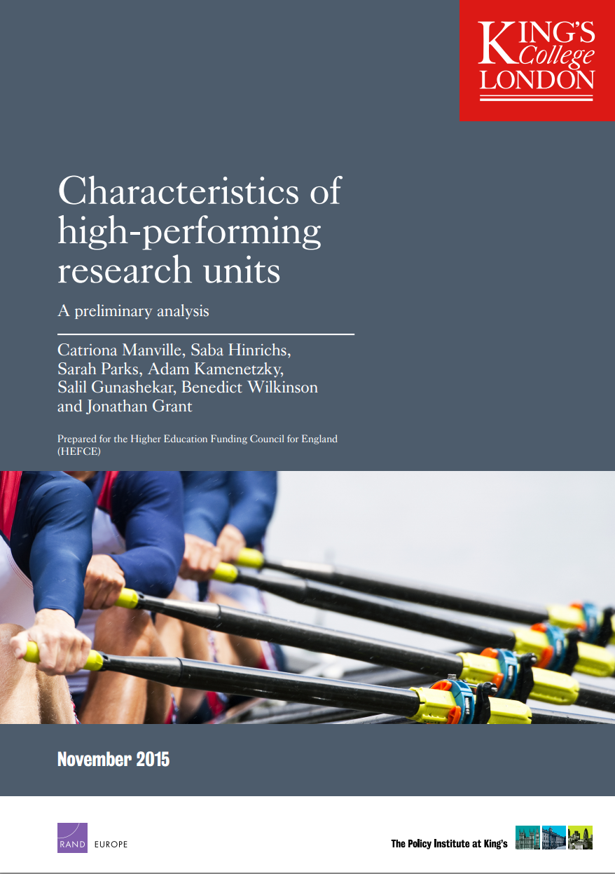
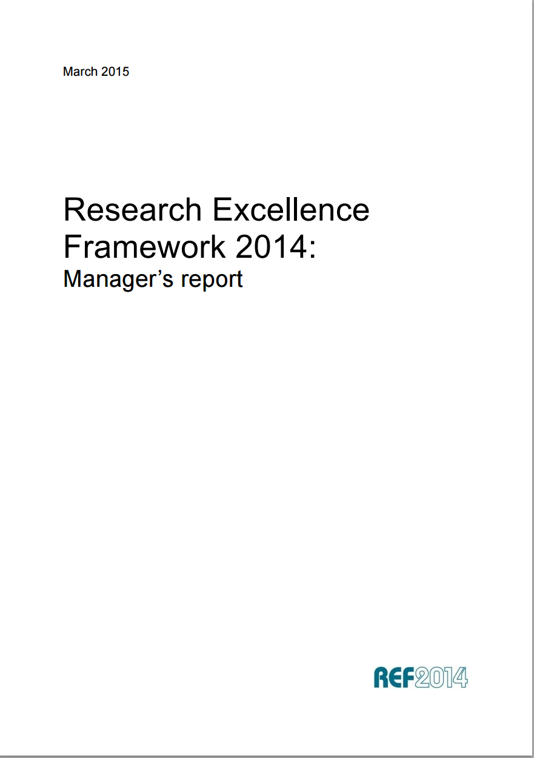
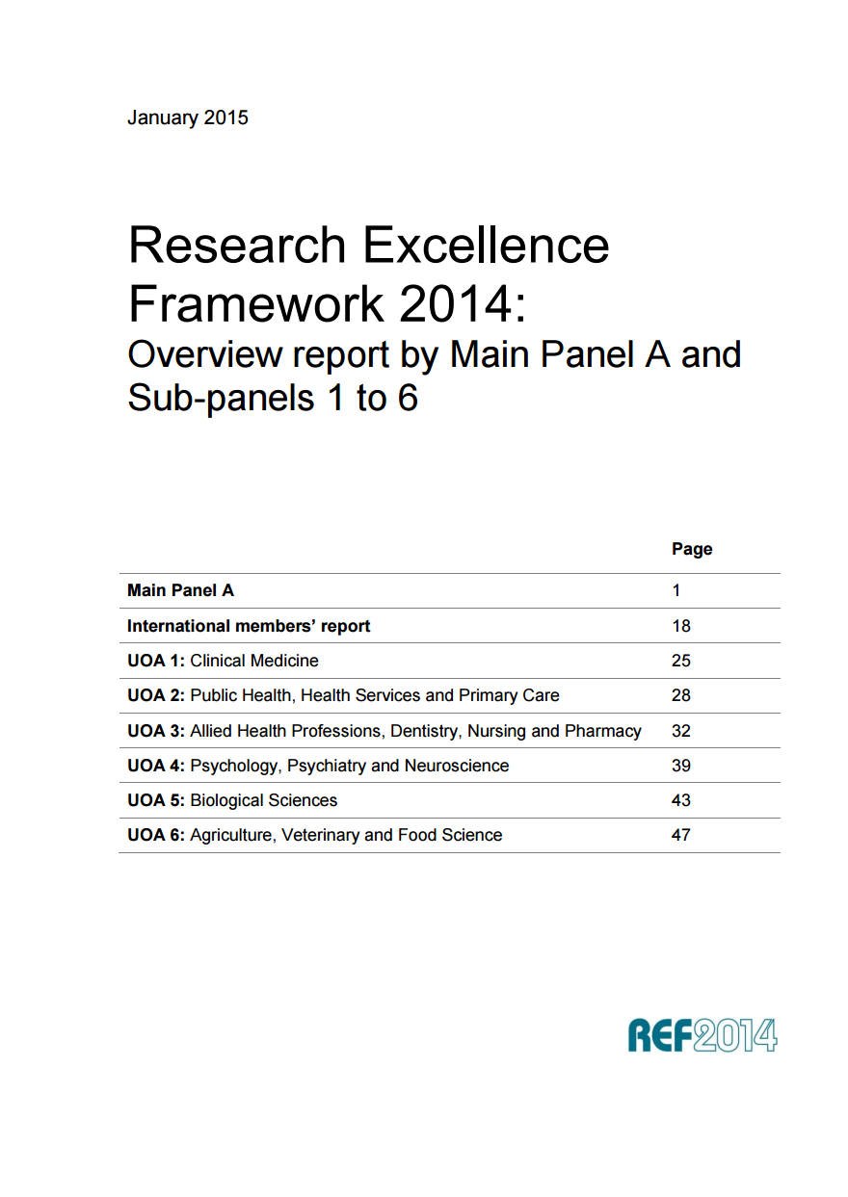
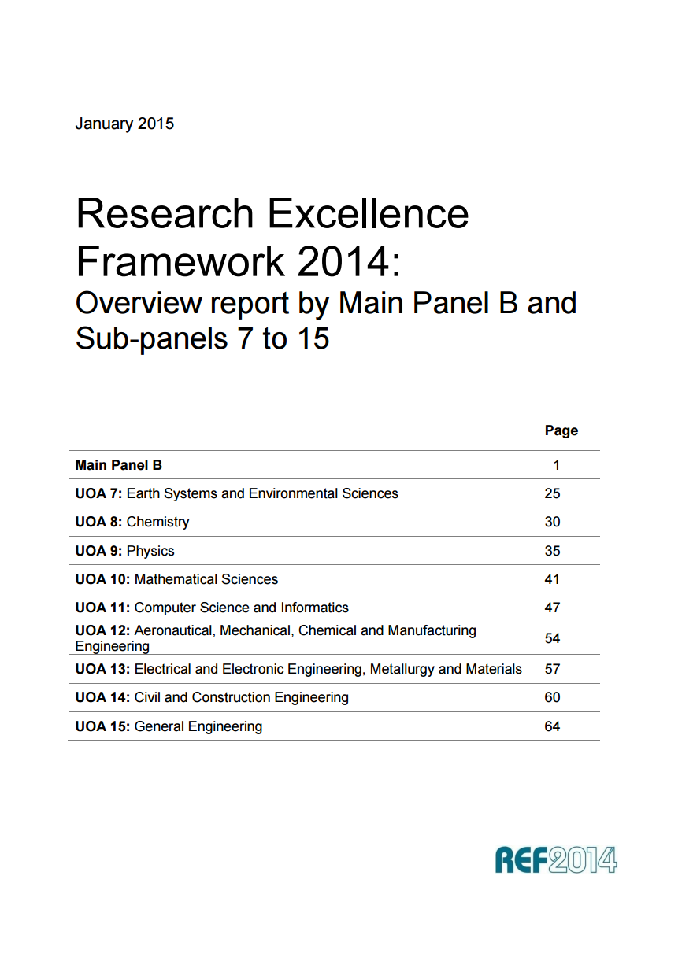
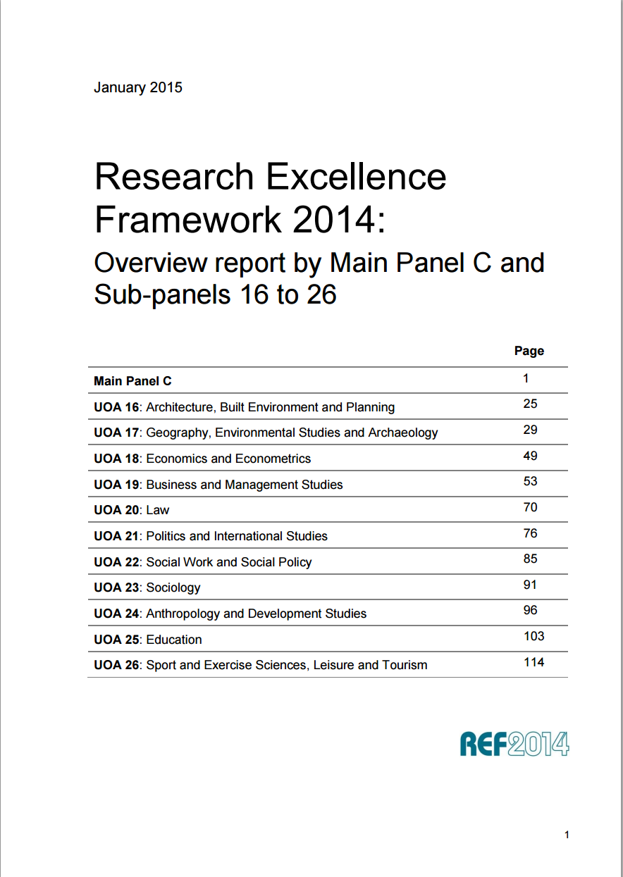
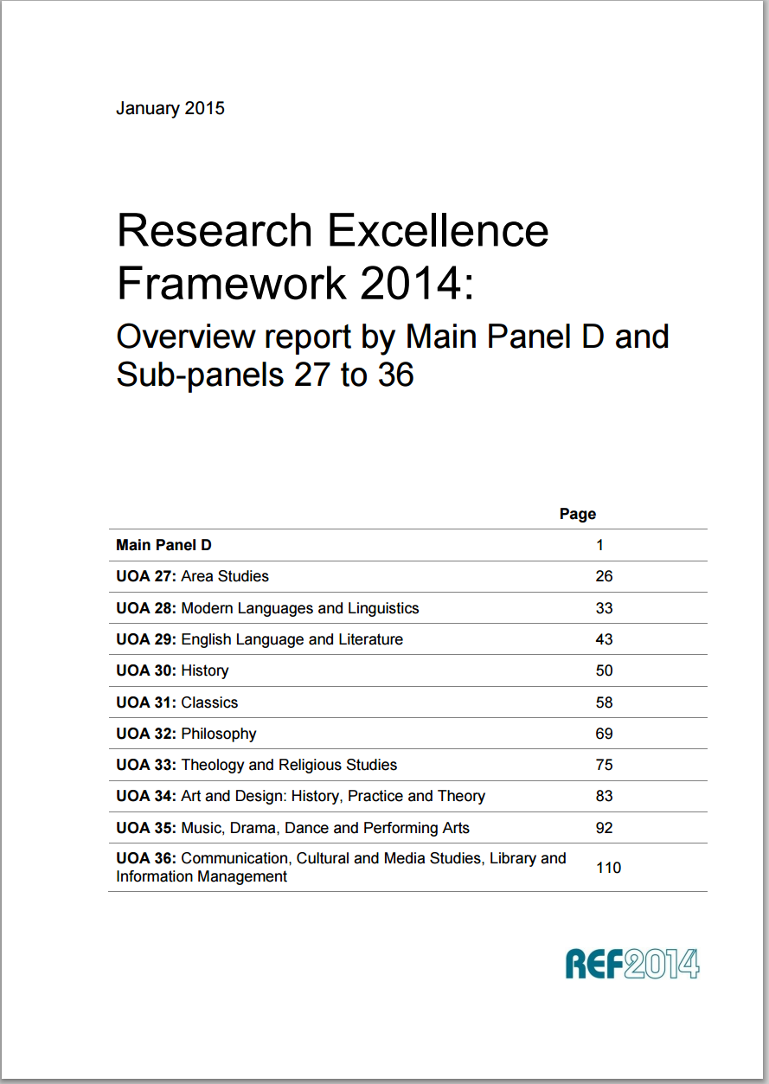
REF: the evidence

Slide 54
Myths and Anxieties
Some impact is negative (Yes, but Panels can handle)
All research must have impact (No)
Only economic impact counts (No)
The best impact does not come from the best research (Perhaps, but we need to know that)
Arts and Humanities cannot demonstrate impact (No)
Impact cannot be ‘measured’ (Yes, but it can be assessed)
It takes time for happen (Yes, so allow for it)
The expectation of impact is a threat to academic freedom (No)
Impact will become an industry (Only if you let it be so)
Measures will become targets (Depends if you own the agenda)
Notes:
54

Slide 55
Challenges
Assessing impact isn’t perfect – but we can learn and make it better
There will be opposition from vested interests - uncomfortable change for university leaders and for academics
We don’t have enough to offer to make it worthwhile
Our traditional purposes will be eroded and …..
Our research policies are already optimal – perhaps we will indeed discover that
We can do the same thing with a few simple metrics
Notes:
55

Slide 56
What have we learnt
  Case studies are a lot of work – but why?
  The attitude to impact has been transformed in universities
  The understanding of impact is much enhanced and – by analysing the case studies as a whole – was even greater than anticipated
  It was costly

Slide 57
  What we don’t know yet
  Is research excellence highly correlated with research impact (and what are the implications)?
  How difficult is it to assess case studies across all disciplines?
  Which of the difficulties in assessment were particularly challenging?
  Will the revitalised approach to impact persist?

Slide 58
Next Steps
‘If only the government would take the lead’
‘There needs to be a funding reward for impact’
Or should universities own and shape their futures?
Cannot our best brains craft the solution which makes universities more central to societal futures?
Or is collective action beyond us in the same way it sometimes seems to be beyond government?
Notes:
58

Slide 59
Conclusion
Government should be clear about its values
Research instruments should recognise and reward what is valued so that incentives are provided
Value judgements should not be a solely internal affair
Methodology to do this was developed in Australia
  Taken forward and piloted successfully in the UK
  Implemented on large scale in the UK and will be evaluated
  Further refined and piloted successfully in Australia
Education & Research directions and outcomes driven by understanding of societal needs and contributing to societal outcomes
Notes:
59

Slide 60



Notes:
The abstract pattern can be removed or repositioned if required. Be careful to ‘Send to Back’ so that it does not obscure any important information.

Slide 61



@ResEngland

